Slide 1
Visual Analytics: Evaluation
Ian Nabney
ian.nabney@bristol.ac.uk

Slide 2
Overview
Building on the lecture VisValidation in week 2
Understand practical methods for evaluating information visualisation
Aware of some methods for evaluating dimensionality reduction
Plan these for the coursework

Slide 3
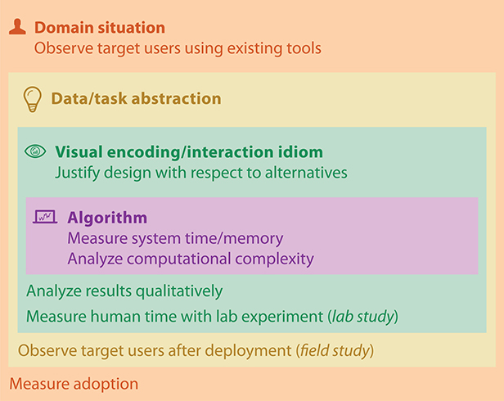
Four levels of design
Situation level concerned with application domain
Next is what-why abstraction from specific domain
Third is how - is the design of idioms that specify the approach to visual encoding and interaction
Last level is the design of algorithms to instantiate those idioms computationally.

Slide 4
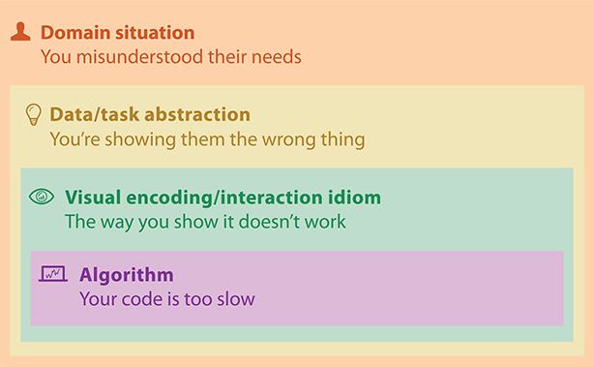
Threats to validity

Slide 5
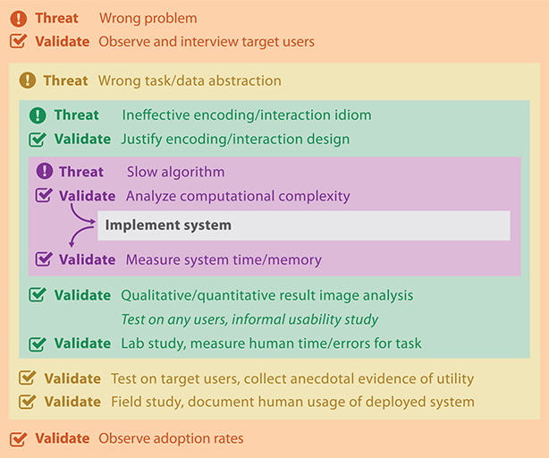
Validating against threats
Distinguishes between pre- and post-implementation approaches
Munzner uses the terms ‘immediate’ and ‘downstream’

Slide 6
Evaluating Visualisation Techniques
Why is evaluation difficult but important?
User-based evaluation: perceptual/subjective evaluation, study design
Metric-based evaluation
Model-based metrics and their limitations
Unsupervised learning metrics
Task-based metrics

Slide 7
Why is evaluation important?
There is a need to compare the ‘quality’ of different visualisations
This matters to algorithm developers to demonstrate the value (or lack of it) of new techniques
This matters to practitioners since they are likely to generate multiple visualisations (parameter settings, different visualisation methods), sometimes in the thousands, and need to choose between them or guide the process of visualisation.
This relates to automation or semi-automation of analysis process.

Slide 8
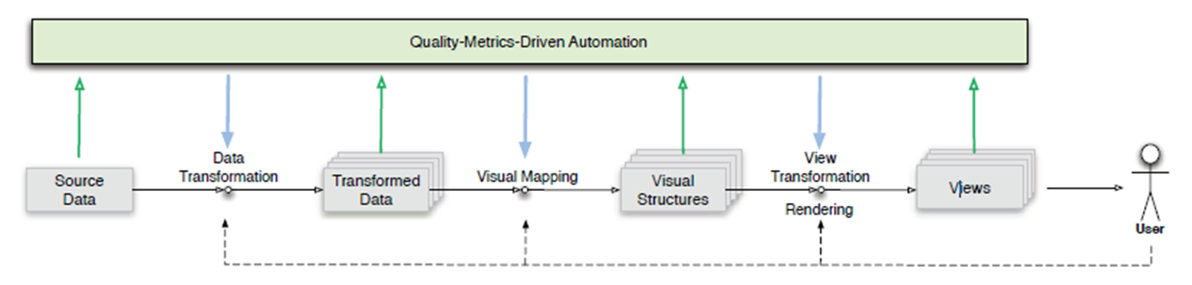
Visualization pipeline
Quality metrics can be calculated in the data space, image space or a combination of the two. Metrics calculated at the View stage draw information from the rendered image, whereas the others draw information from the data space and elements of the visual structures
Quality metrics generate help evaluate alternatives.
Metrics do not replace the user. Indeed, the whole purpose of data visualization is to aid a human user in data analysis.

Slide 9
Performance measurement
User accuracy at performing the task
Time to perform task
Emotional response
Confidence that users have in their answers (and hence a measure of effectiveness)
Stress caused by a technique
Qualitative feedback in the form of a questionnaire that lets the user provide additional information

Slide 10
Before the study
Identify the tasks (keep them general and reasonably short)
Create fair visualisations of the data for all visualisation techniques involved
Identify/solicit an unbiased sample of users
Attempt to balance gender, age, ethnicity and other characteristics of your intended user base
Create a written description of the study and its purpose for participants
Provides purpose to participants
Important for informed consent (and ethical approval for larger studies)
Prepare a questionnaire if you are using one (and ideally trial it)
Ensure that you are able to record data about participants

Slide 11
Pilot evaluation
Before you run the study, it is always a good idea to
Take the study yourself to identify potential problems with the study
Perform a pilot evaluation with a small number of participants to make sure the tasks, visualisations and descriptions are not ambiguous
This allows you to fix problems before the study

Slide 12
Analysis
Quantitative analysis
Identify statistical significance for performance metrics
Student t-test for comparing two metrics
ANOVA (Analysis of Variance) for more quantities
Provide a p-value
Qualitative analysis
‘Think aloud’ feedback useful
Answers to the questionnaire provide crucial feedback about preferences, difficulties, ideas for improvement etc.

Slide 13
Why is evaluation difficult?
Dimensionality reduction is an inherently unsupervised task – there is no ‘ground truth’ or ‘gold standard’.
There is no single globally correct definition of what quality means.
There is a wide variety of dimensionality reduction methods with different assumptions and modelling approaches
How can we tell? Not many papers on the subject!

Slide 14
Evaluation depends on purpose
Use visualization both for specific tasks but also data-driven hypothesis formation.
Metric should measure what the user requires the visualization for:
Accurate representation of data point relationships (local/global)
Good class separation: ‘clustering’ (many types)
Identification of outliers
Reduction of noise
‘Understanding’ data – perception of data characteristics
Choosing how to represent data

Slide 15
User-based evaluation
Evaluating user performance
Evaluating user experience
How large is the search space?
How many users do you need?
Richer qualitative data (e.g. reaction cards, choosing cards/words to reflect UX)
Humans not good at quantifying what they see (e.g. is one plot ’more structured’ than another?).

Slide 16
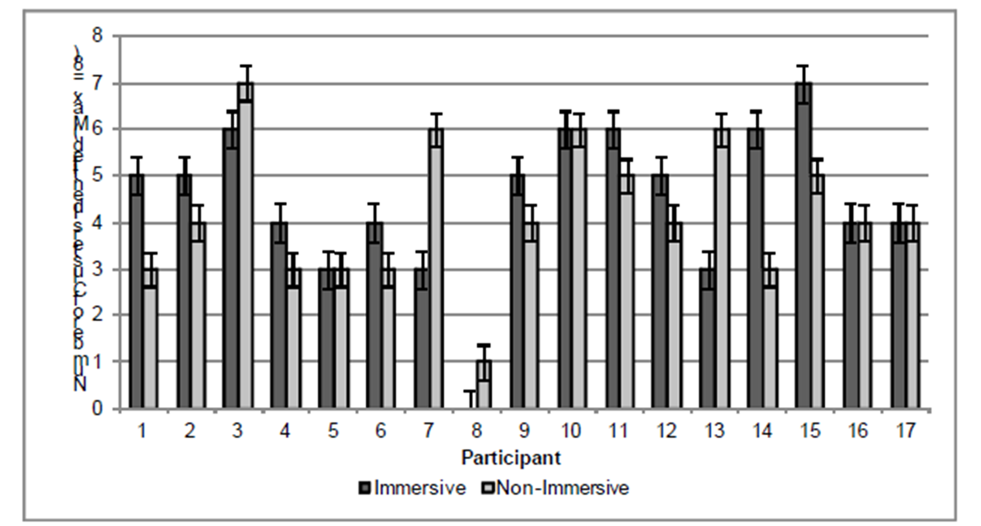
Cluster Identification Task
8 clusters in the data: average identified in immersive was 4.5; non-immersive was 4.2

Slide 17
Metric-based evaluation
Model-based evaluation
Unsupervised learning metrics
Task-based metrics
Most models have an associated cost function
Neuroscale, MDS: stress
T-SNE: topographic cost function
PCA: variance
GTM, GPLVM, probabilistic PCA: log likelihood
But:
Some models don’t have a cost function (SOM)
Cost functions are incompatible
Need some form of regularisation to compare different architectures/parameter spaces
So, only good for comparing a relatively narrow set of possible models

Slide 18
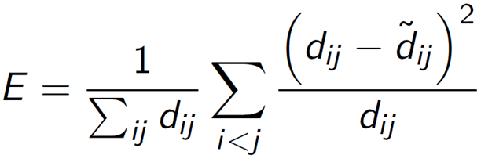
Unsupervised learning metrics
Stress can always be calculated – but is it always relevant? (Alternative is to measure correlation of data and visualization space distances).
Metrics that take account of local neighbourhood preservation
Visualization Distance Distortion: compute k nearest neighbours for each point and measure the relative stress (or similar) for these points
Trustworthiness measures the fraction of data points distant in the data space that become neighbours in the projection space
Continuity measures the fraction of neighbouring data points in the data space become distant in the projection space.
Mean relative ranks in data and latent space are similar to these, but consider weighted rankings of neighbourhood points.

Slide 19
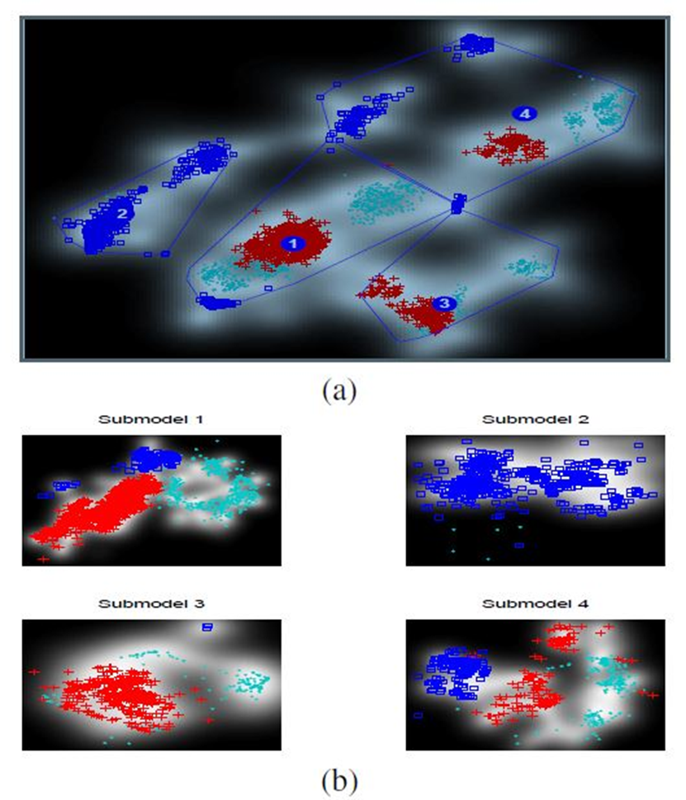
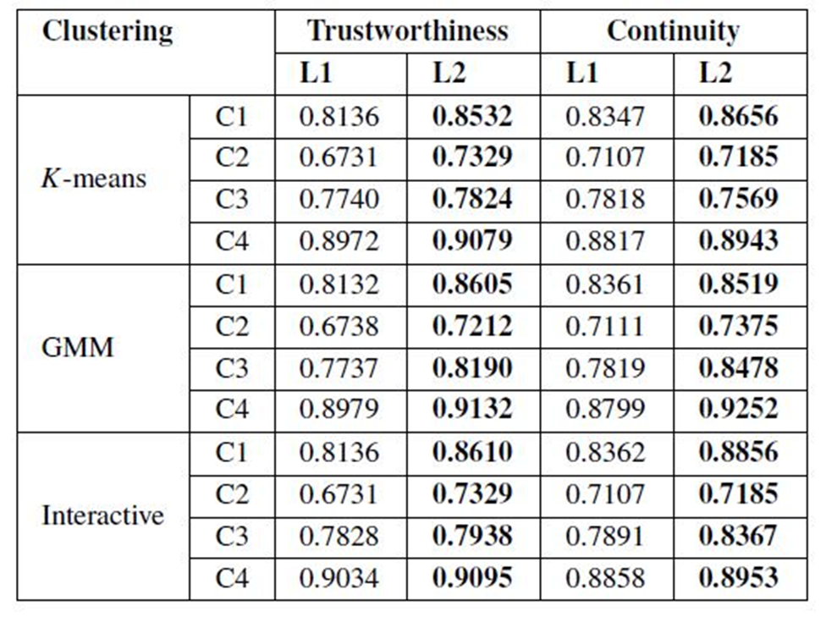
Case Study: hierarchical visualisation

Slide 20
Task-based metrics
Objective metrics based on task to be performed, but without the use of trials or subjective experiments
These metrics often work best in a semi-supervised way: with additional class information
For example – if we want the visualization to tell us about class separation, need a measure of class separation in the visualization space
If we want the visualization to preserve class information, use the nearest-neighbour classification error (in visualization space) normalised by value in data space

Slide 21
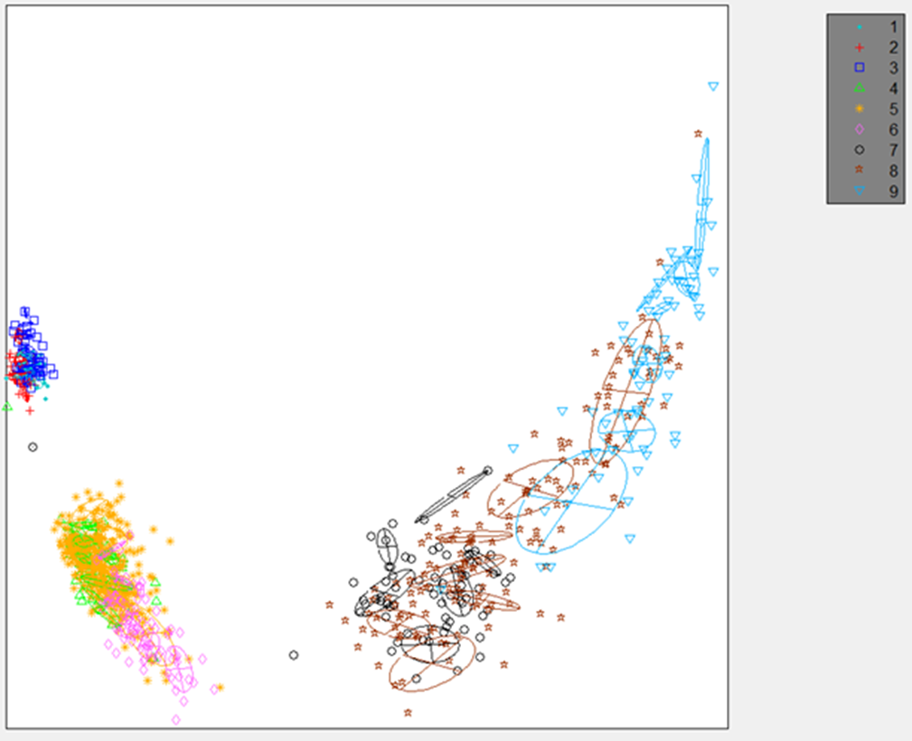
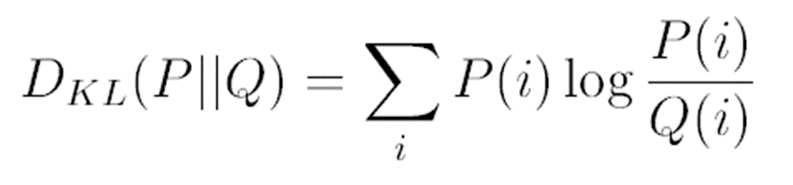
Case Study: Helicopter Airframe
Known classes corresponding to flight modes
Fit a Gaussian mixture model (GMM) to each class in visualization space. Use a variational Bayesian algorithm to automate model complexity
Compute Kullback-Leibler distance between all possible class pairs GMMs as a measure of overall class separation.

Slide 22
Summary
Challenging because no ground truth
Task-based metrics acknowledge the purpose of visualization, but tend to be harder to make objective
Important to study the correlation between task performance metrics (as carried out by humans) and quantitative task-based metrics
Common question asked by practitioners, so important to make progress
Further reading: Carpendale, Sheelagh. "Evaluating information visualizations." Information visualization. Springer, Berlin, Heidelberg, 2008. 19-45. https://link-springer-com.bris.idm.oclc.org/content/pdf/10.1007%2F978-3-540-70956-5_2.pdf

